Slide 1

Codergirl – Frontend
Unit 2 - Class 11
Jan 13, 2021
Notes:
1

Slide 2
Agenda
Section 17 – Pipes
Studio – Assignment # 8.
Notes:
2

Slide 3
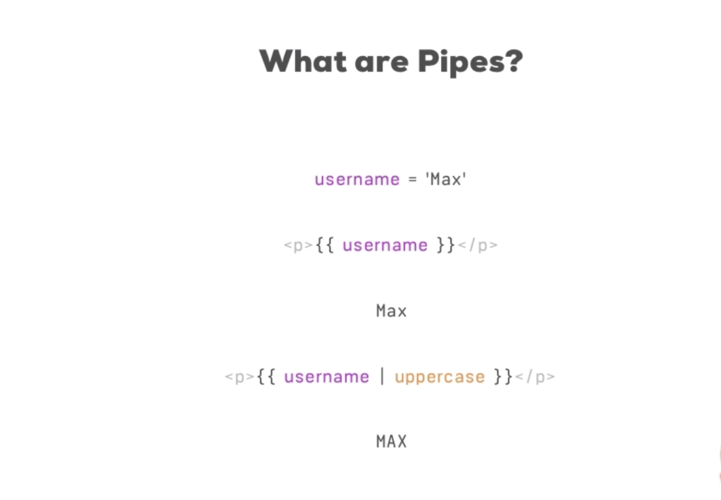
Pipes
Transform value
Notes:
3

Slide 4
Using built in pipes
Notes:
4

Slide 5
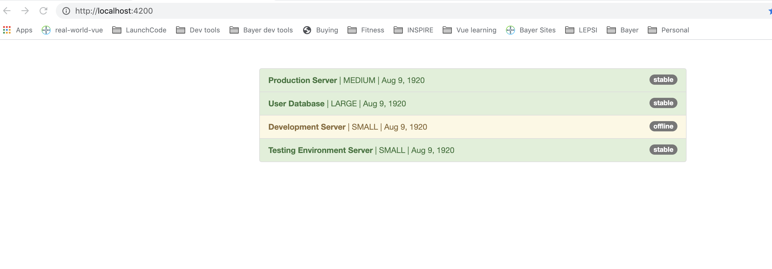
Using built in pipes
Notes:
5

Slide 6
Parametrizing pipes
Notes:
6

Slide 7
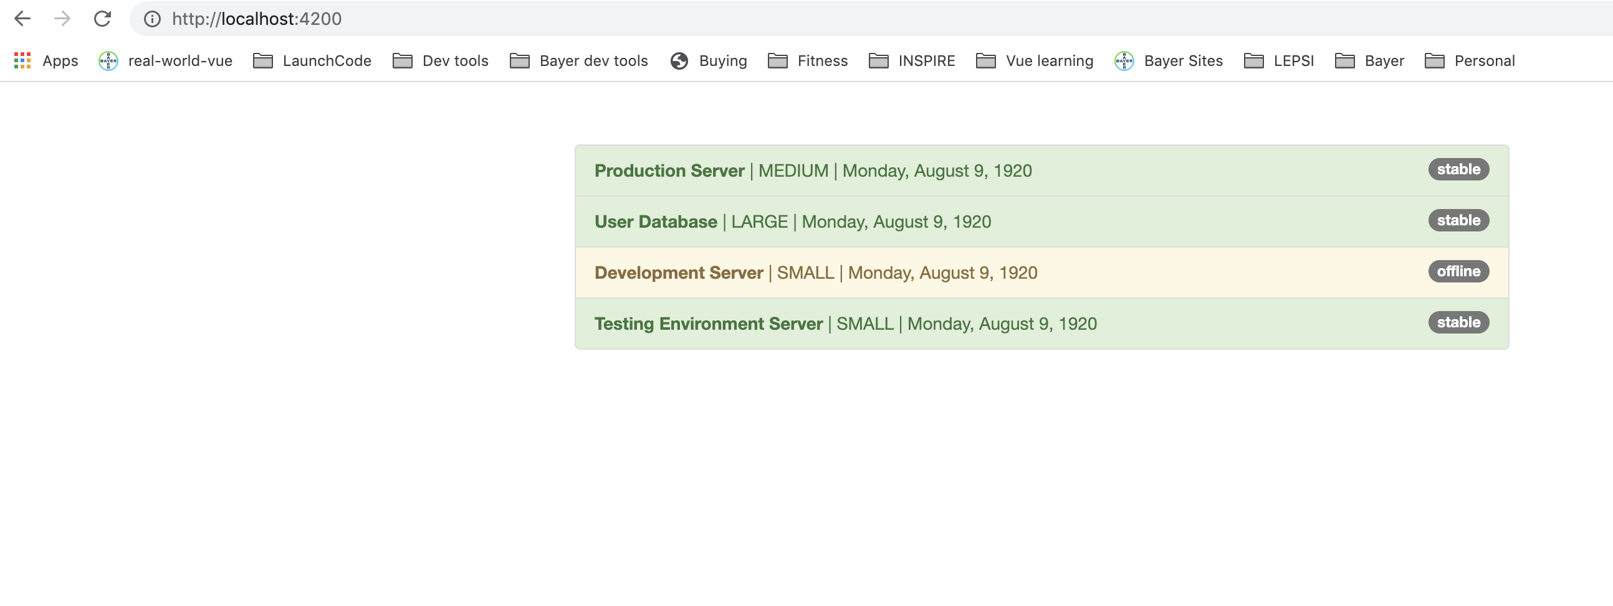
Parametrizing pipes
Notes:
7

Slide 8
Built in pipes
https://angular.io/api?query=pipe
Notes:
8

Slide 9
Chaining multiple pipes
Notes:
9

Slide 10
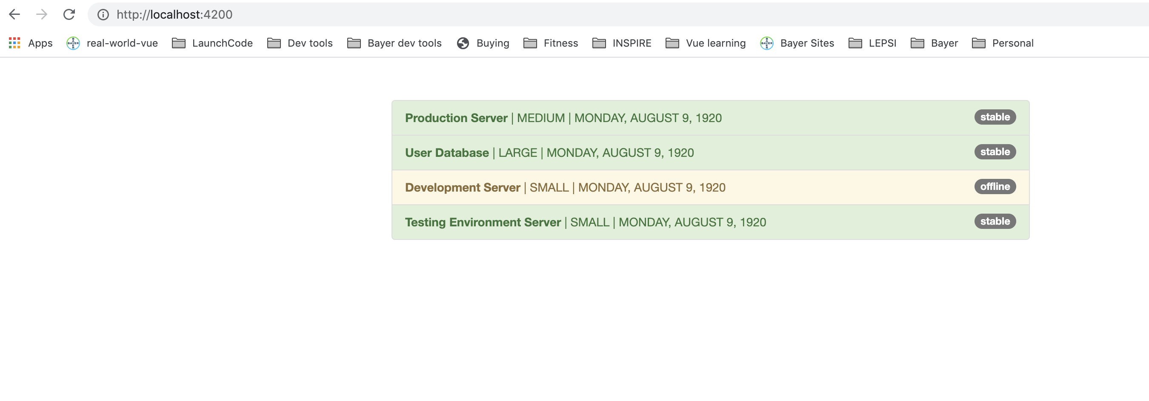
Chaining multiple pipes
Notes:
10

Slide 11
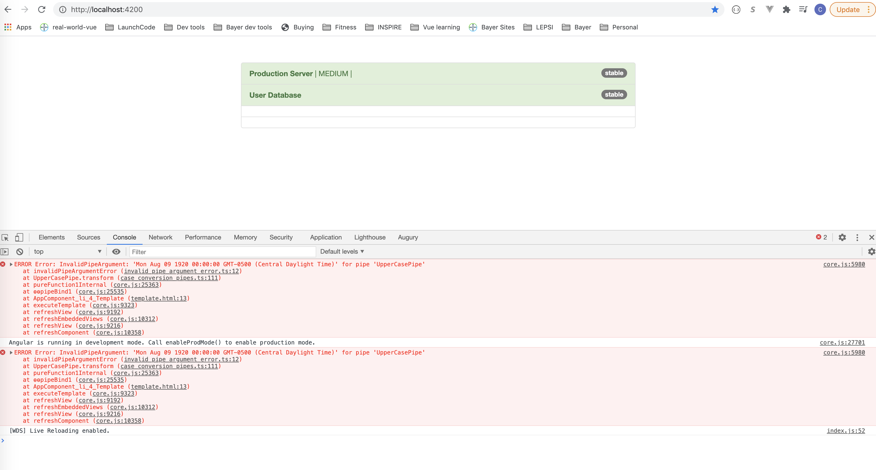
Chaining multiple pipes
Notes:
Reactive approach is cool that the model in the form matches what you setup in TS code.
11

Slide 12
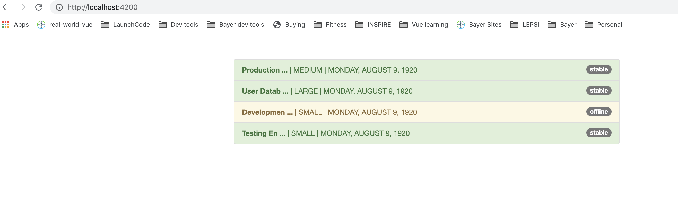
Creating a Custom Pipe
Create the shorten.pipe.ts
Add it to App Module and html
Notes:
12

Slide 13
Parametrizing Custom Pipe
Notes:
13

Slide 14
Parametrizing Custom Pipe
Notes:
14

Slide 15
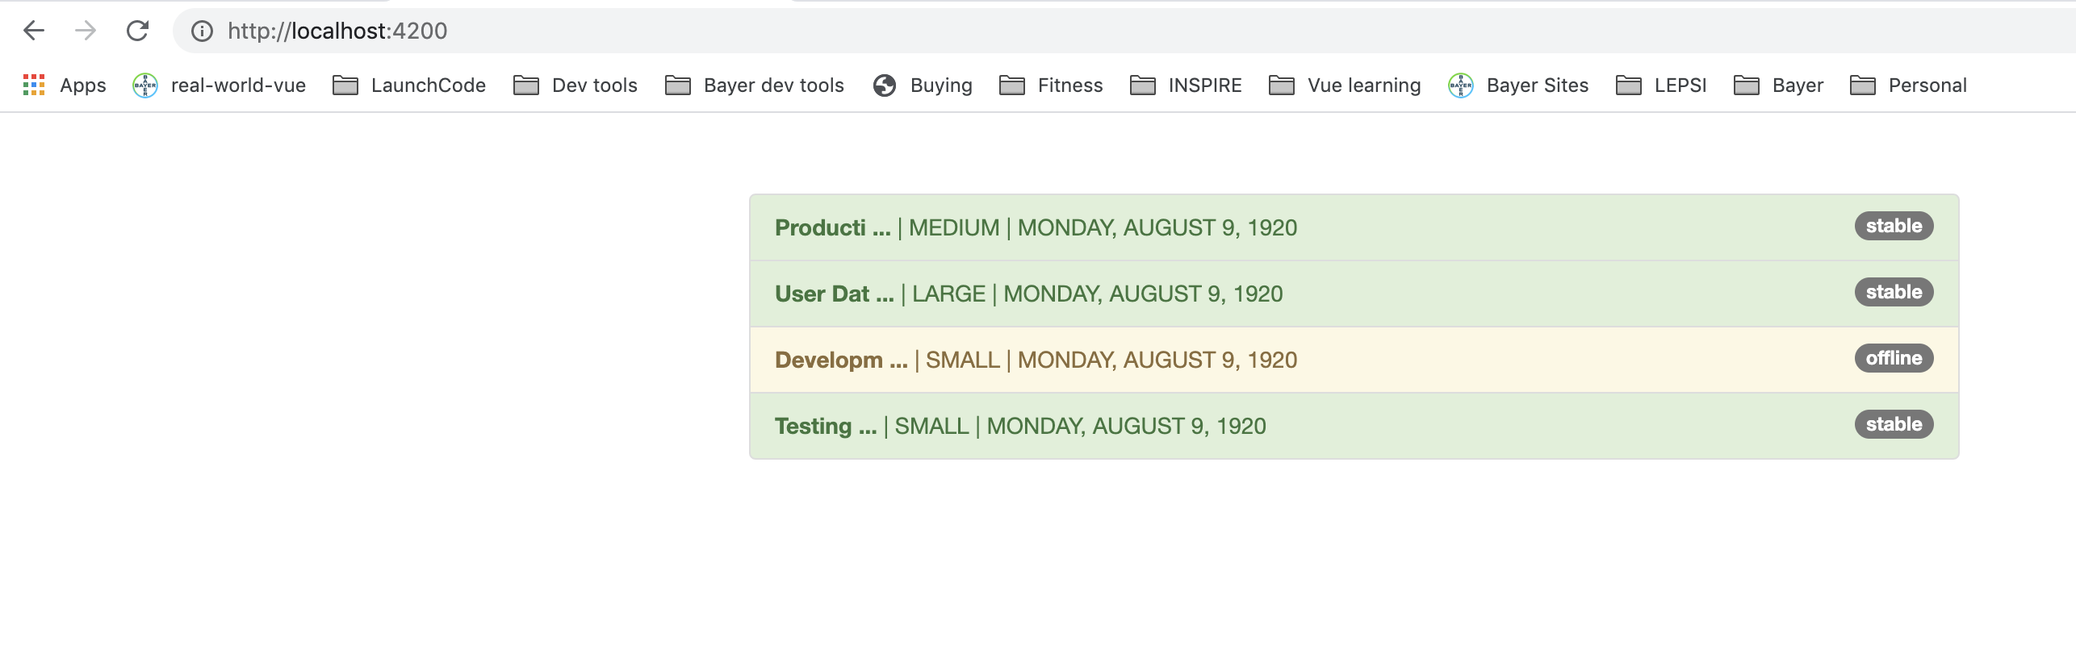
Parametrizing Custom Pipe
Notes:
15

Slide 16
Creating a Filter Pipe
ng g p filter
Notes:
16

Slide 17
Creating a Filter Pipe
Notes:
17

Slide 18
Creating a Filter Pipe
Notes:
18

Slide 19
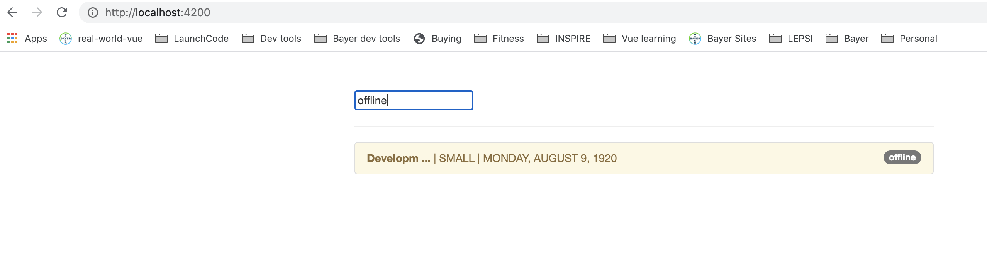
Creating a Filter Pipe
Notes:
19

Slide 20
How to fix a Filter Pipe
Notes:
20

Slide 21
Understanding the “async” pipe
Notes:
21

Slide 22
Understanding the “async” pipe
Notes:
22

Slide 23
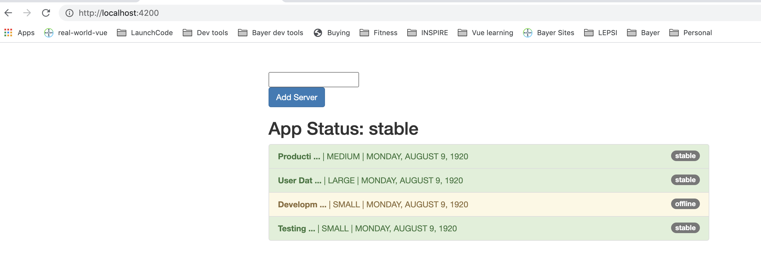
Understanding the “async” pipe
Notes:
23

Slide 24
Questions?

Slide 25
Studio
Assignment 7: Practicing Reactive Forms
Section 16 - Course Project - Forms

